Slide 1
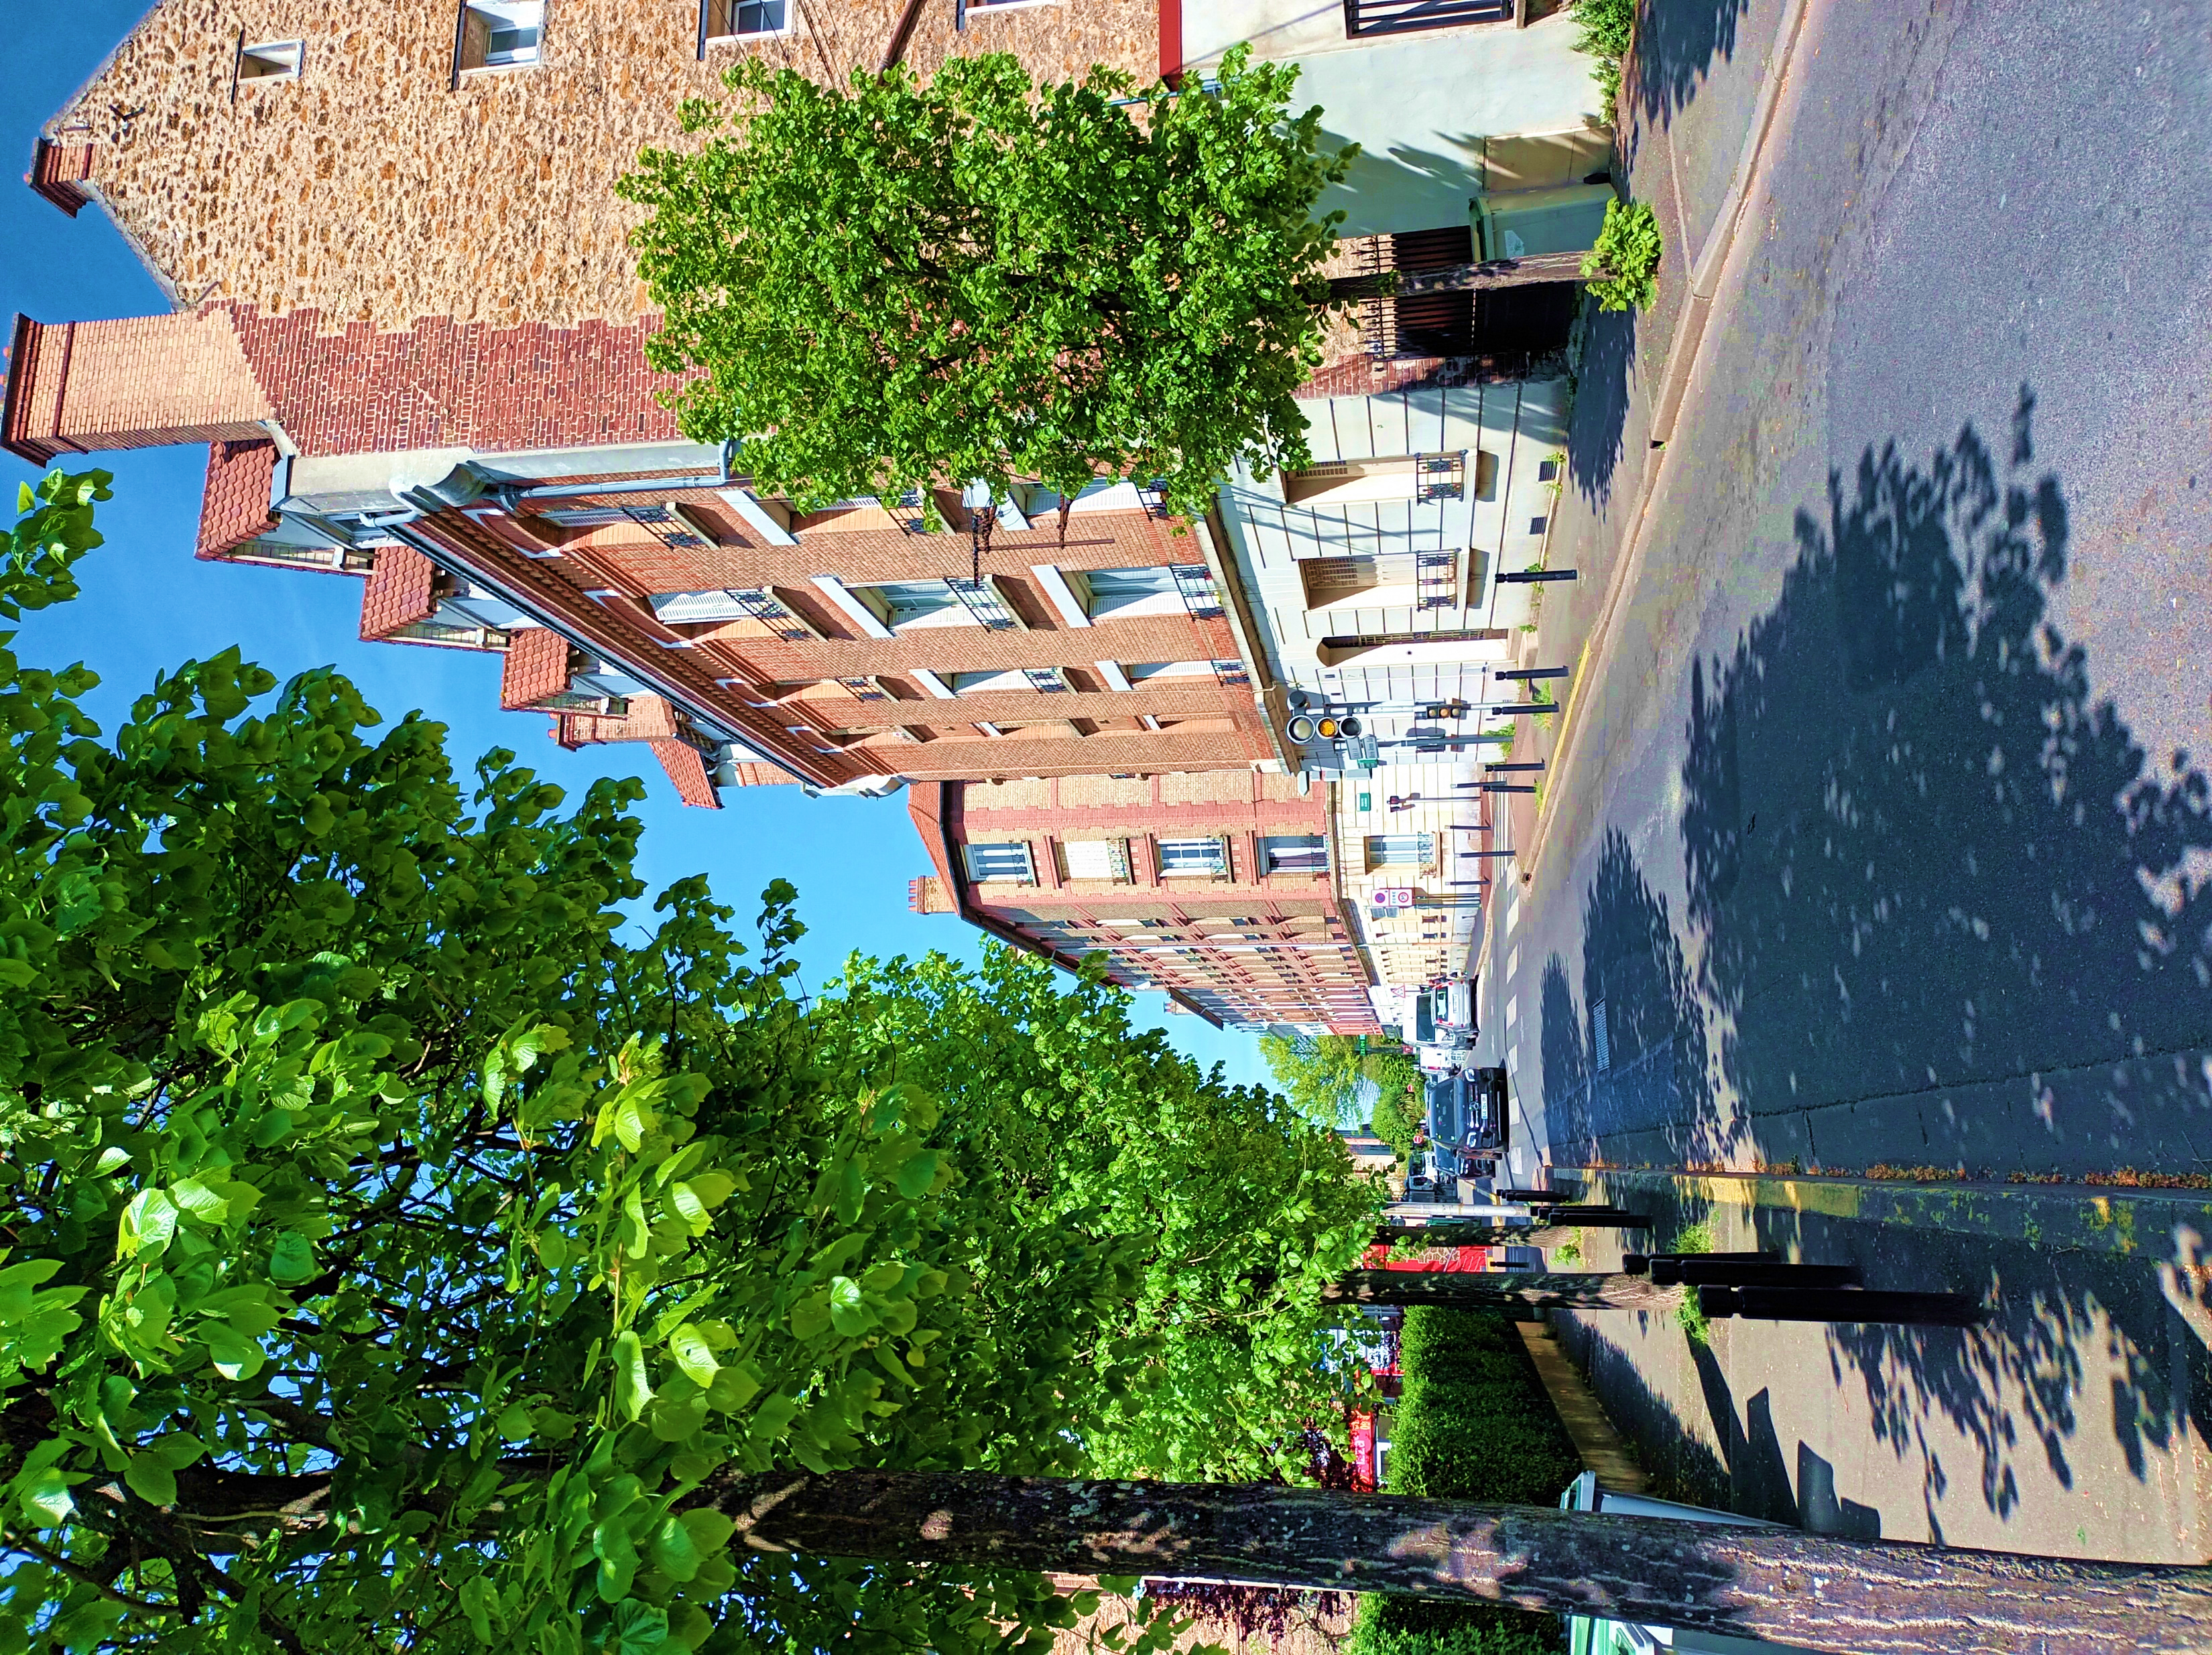
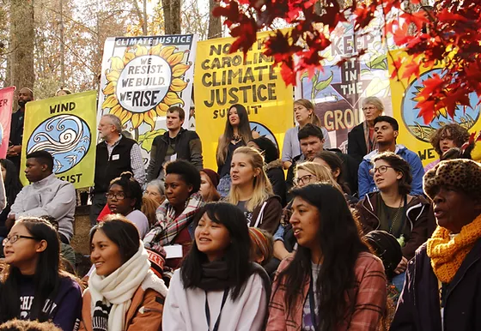


Ecological Degradation and Socioeconomic Discrimination through an Ecofeminist Perspective
Subject
Vulnerable communities tend to be victims of intersectional discrimination where variables such as race, ethnicity, gender, handicap and age converge, augmenting exposition to discriminatory situations. Focusing on France and the United States, the case studies concentrate on communities disproportionately exposed to risk industries and contaminant bi-products which diffuse into the air, soil and waterways affecting habitats and both human and non-human life. An ecological discrimination is considered which operates against these populations of historic discrimination and/or modest socioeconomic status though nonobstant in its reach. The role of women in an ecofeminist dynamic emerges, compelling greater social and environmental justice.e..
Cases
France: Aulnay-sous-Bois, Vincennes, Sainte- Pazanne, Nice.
United States: Flint, Michigan, « Cancer Alley », LA, « Standing Rock » Reservation N/SD, Uniontown AL, Lawrence, MA.
Perspectives & Findings
Citizenship models (Ethno-national /Identity politics v. Republican Model/ Universalism)
Pollution Overlapping & Toxic Cocktails
Diffusion-Exposome
Class-action capacity
Methodology: Case-law, doctrine, local and national statistics, terrain research and interviews allow for cross-fertilization and a global apprehension of the targeted cases.
Christina R. Brown – Directed by M. Mercat-Bruns & P. Steichen
Photo- https://www.ncclimatejustice.info/nc-climate-justice-summit

